Slide 1
Shape Descriptor
Derya ŞAHİN 2014555057
İsa İMADOĞLU 2015555038
Okan Can SAĞLAM 2014555053

Slide 2
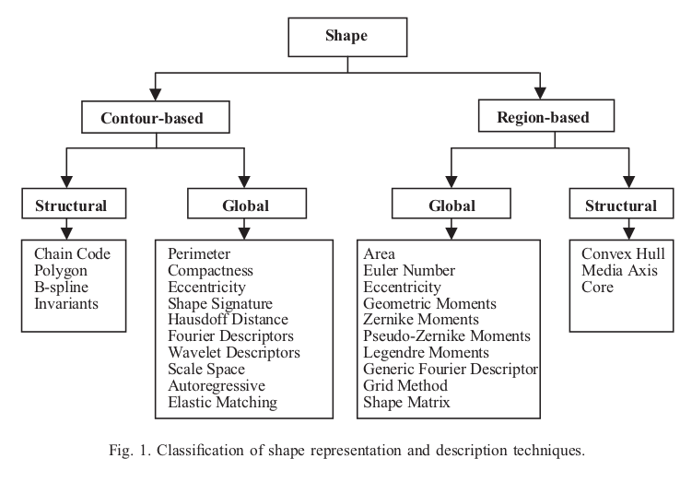
Shape Description Techniques

Slide 3
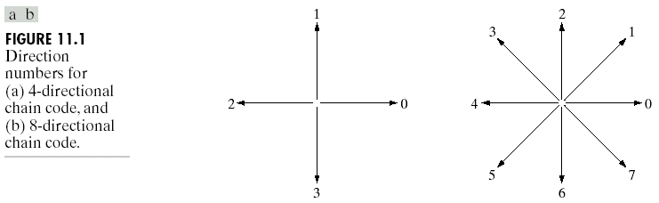
Chain Code

Slide 4
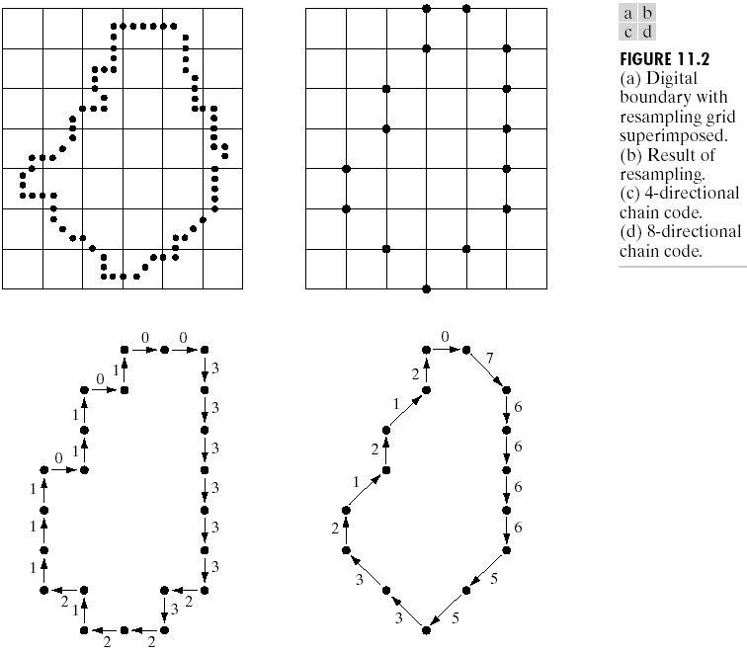
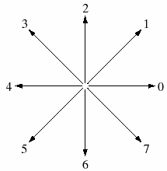
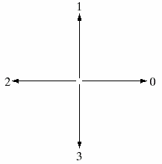
Chain Code Example
Chain Code: 0033333323221211101101
Chain Code: 076666553321212

Slide 5
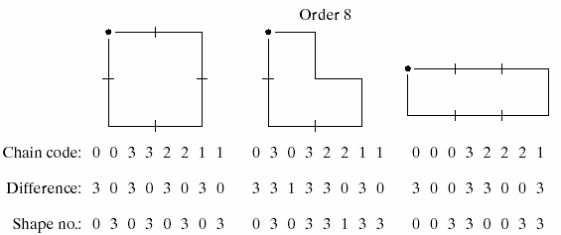
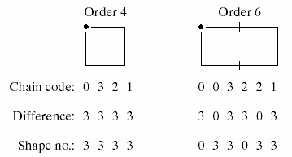
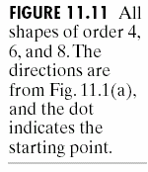
Differential Chain Code and Shape Number

Slide 6
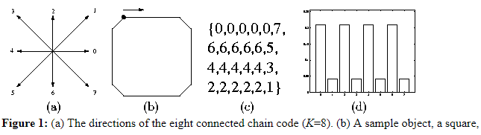
Chain Code Histogram

Slide 7
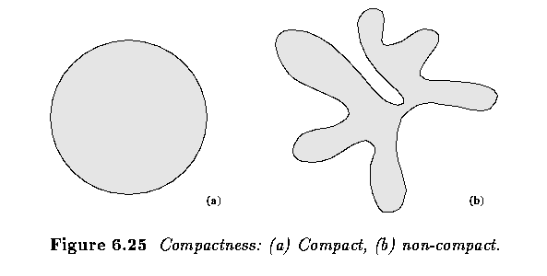
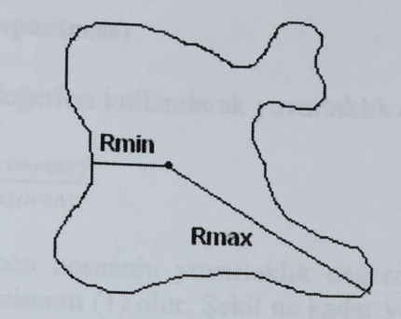
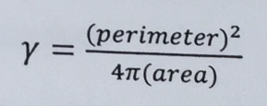
Some Simple Descriptors
Perimeter
Area
Eccentricity
Compactness
Rmax
_____
Eccentricity =
Rmin

Slide 8
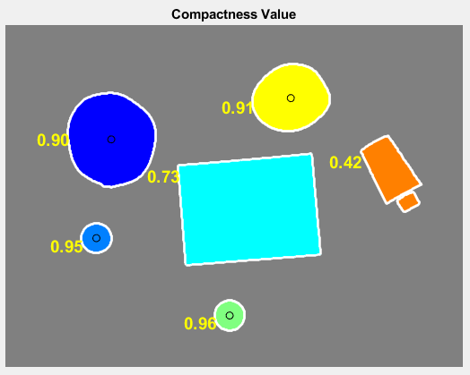
Compactness Example

Slide 9
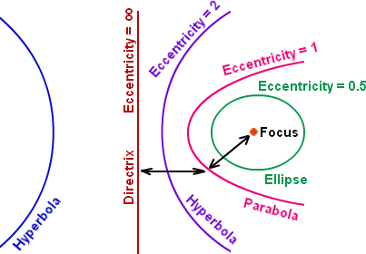
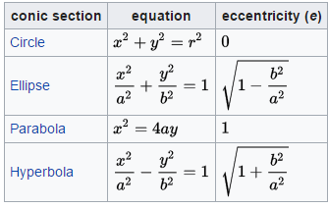
Region-Based Eccentricity

Slide 10
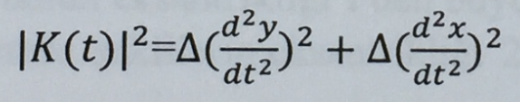
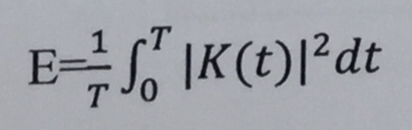
Curvature and Bending Energy

Slide 11
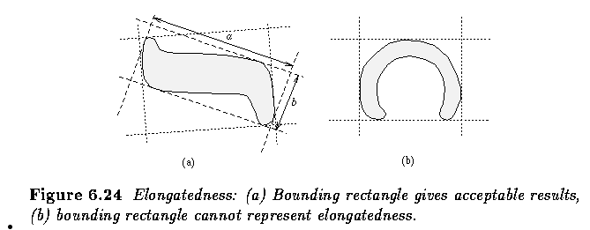
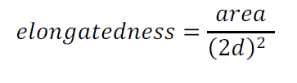
Elongatedness
d=maximum thickness

Slide 12
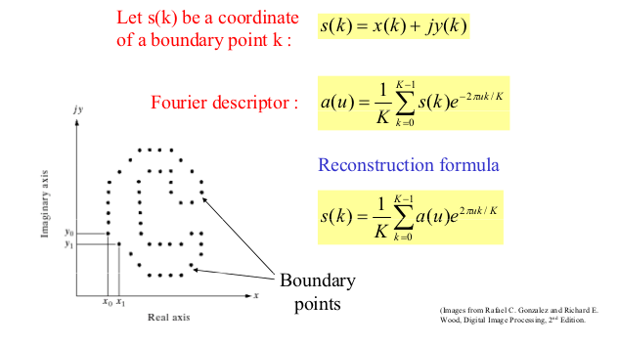
Fourier Descriptors

Slide 13
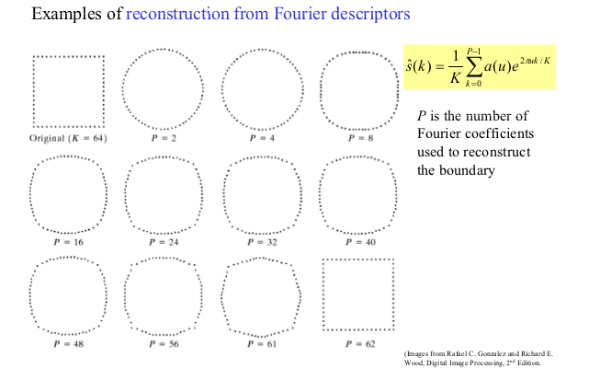
Examples of Reconstruction From Fourier Descriptors

Slide 14
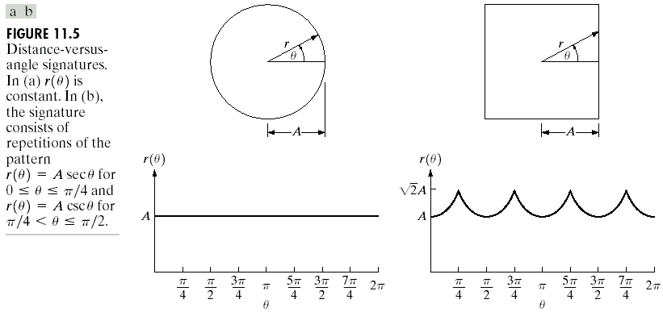
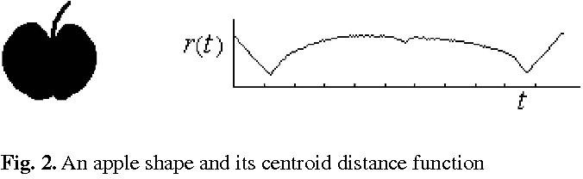
Signature

Slide 15
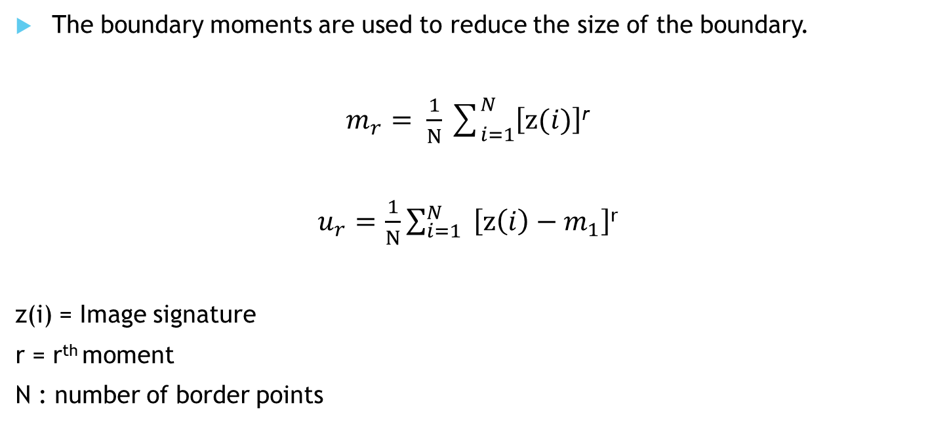
Boundary Moment
The boundary moments are used to reduce the size of the boundary.
$m_{r}= \frac{1}{N}\sum_{i=1}^{N}{\left[z(i)\right]}$^{r}
$u_{r}=$ $\frac{1}{N}\sum_{i=1}^{N}{ \left[z\left(i\right)−m_{1}\right]}$^{r}
z(i) = Image signature
r = r^{th} moment
N : number of border points

Slide 16

Boundary Moment
Normalized moments:
$m_{r}^{′}=m_{r}/( μ$₂)^{r/2}
$μ_{r}^{′}=μ_{r}/( μ$₂)^{r/2}
Identifiers of moments to minimize noise in the shape:
F₁=$( μ$₂)^{1/2}/$m_{1}$
F₂=$μ$₃/$(μ$₂)^{3/2}
F₃=$μ$₄/$(μ$₂)²
These values are distinctive features for shapes.

Slide 17
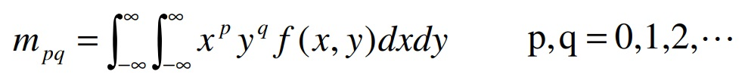

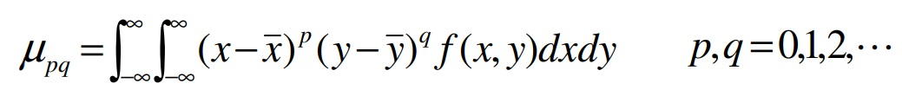
Moment Descriptors
The moments of an image f(x,y) are given by :
Centre of gravity of an object
Central moments

Slide 18
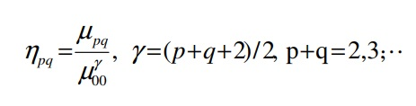
Hu’s Invariant Moments
Moment invariants are firstly introduced by Hu, Hu derived six absolute orthogonal invariants and one skew orthogonal invariant based upon algebraic invariants, which are not only independent of position, size and orientation but also independent of parallel projection.
Scale invariance can be obtained by normalization. The normalized central moments are defined as follows:

Slide 19
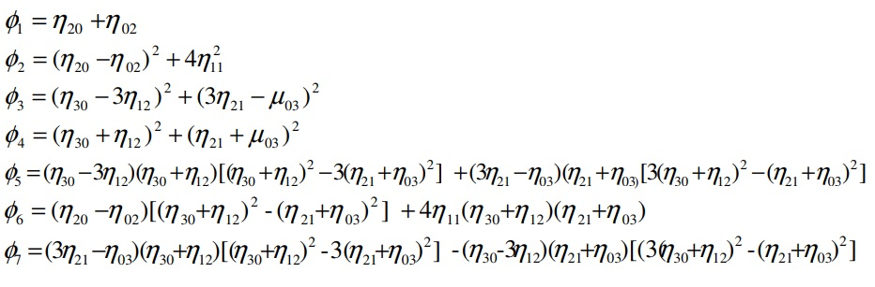
Hu’s Invariant Moments
Based on normalized central moments, Hu introduced seven moment invariants:
The seven moment invariants are useful properties of being unchanged under image scaling, translation and rotation.

Slide 20
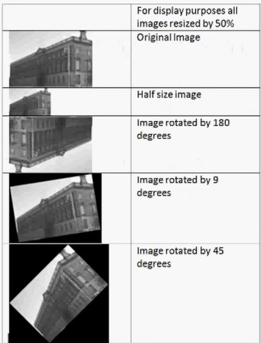
Hu’s Invariant Moments Example

Slide 21
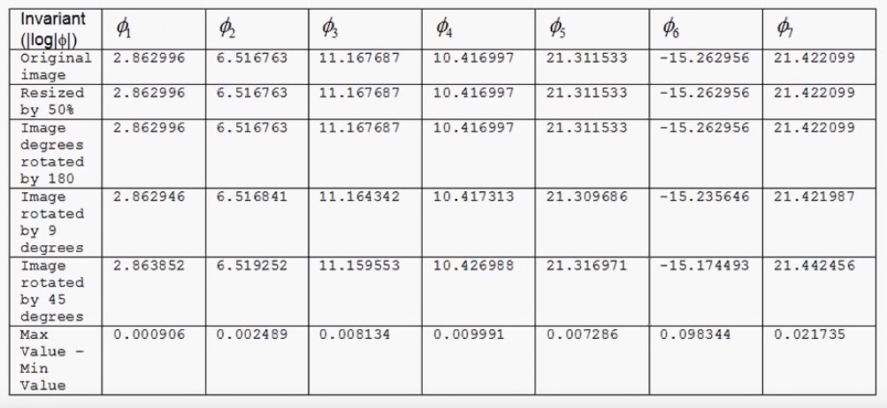
Hu’s Invariant Moments
The seven moments for each of the five image.A log transform was taken to get meaningful values.

Slide 22
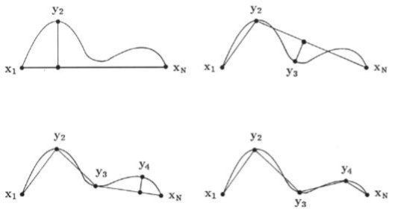
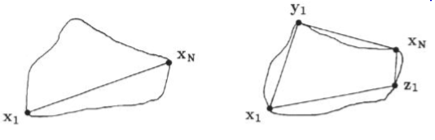
Polygonal Approximation
for finding critical point
Splitting method for polygonal approximations Splitting method for the linear picewise approximation of a closed curve

Slide 23
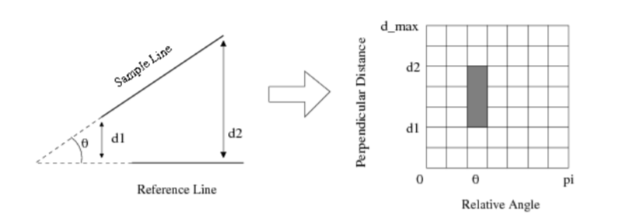
Pairwise Geometric Histogram (PGH)
PGHs are defined for linear edge segments, encoding the relative (perpendicular) positions and orientations of any other linear edge segments in a specified local image region.
Figure xd

Slide 24
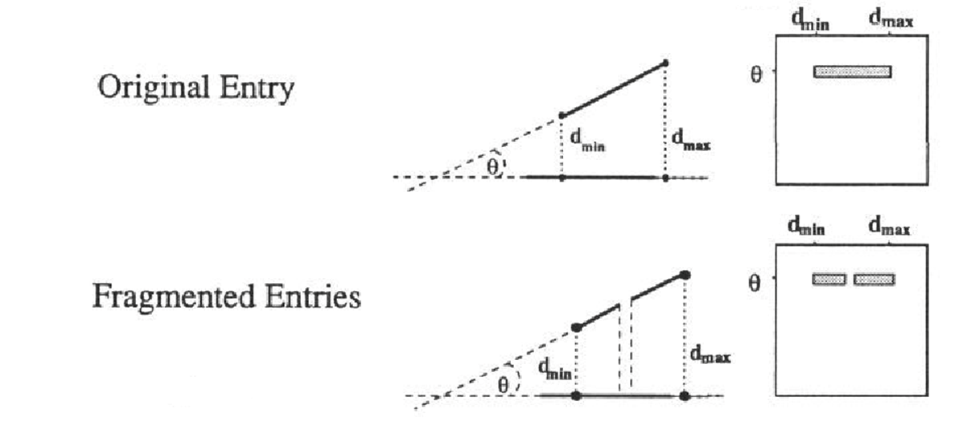
PGH Example

Slide 25
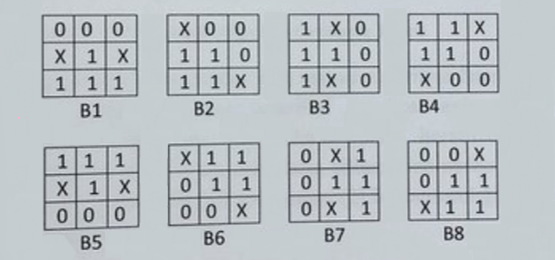
Morphological Medial Axis Transform (MAT)
Initially we have an image, and we implement erosion by B1 filter,
then we implement erosion by B2 filter to the obtained image, and
then we implement erosion by B3 filter to the new image,
and this goes on until B8 filter is implemented.
So our formula is:
A’ = (((((((AxB1)xB2)xB3)xB4)xB5)xB6)xB7)xB8
Figure 2: X= Don’t Care, 1= Active Pixel, 2= Passive Pixel

Slide 26
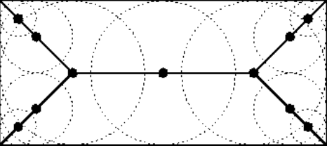
MAT Example
If we use Morphological Medial Axis Transform to a rectangle, then we obtain this Skeleton.

Slide 27
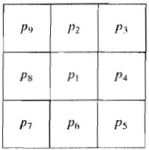
Topological Medial Axis Transform (MAT)
Also known as thinning and is a morphological operation that is used to remove selected foreground pixels from binary images, somewhat like erosion or opening.
By using these rules:
(a) 2 <= N(p1) <= 6
(b) T(p1) = 1
(c) p2.p4.p6 = 0
(d) p4.p6.p8 = 0

Slide 28
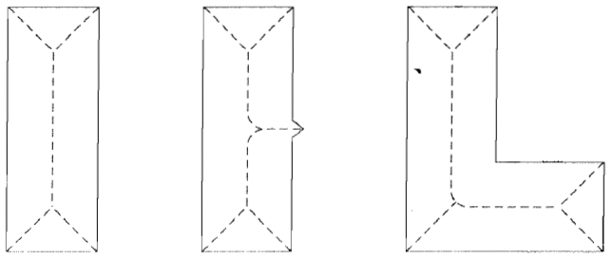
Thinning Example
After we implement TMAT algorithms, we obtain this:

Slide 29

Euler Number
Euler number describes the relation between the number of contiguous parts and the number of holes and a shape. Let S be the number of contiguous parts and N be the number of holes on a shape. Then the Euler number is:
Eul = S - N
So the Euler number of this image is 3-3=0

Slide 30
THANK YOU FOR LISTENING!
Any Question ?

